Slide 1
Data for a
Strong Economy:
Securing a Robust
2020 U.S. Census

Slide 2
ReadyNation
Business initiative of Council for a Strong America (national nonprofit)
2,300+ Business leader members (F500s, small and medium enterprises, chambers)
Promote public policies and programs that build a strong workforce and economy

Slide 3
Overview
Why is the Census Important?
Threats to an Accurate Count
How Business Can Help
Business Spotlights

Slide 4
Census Basics
A count of the population every 10 years is mandated by the Constitution.
2020 will feature first online form but paper and phone questionnaires still available

Slide 5
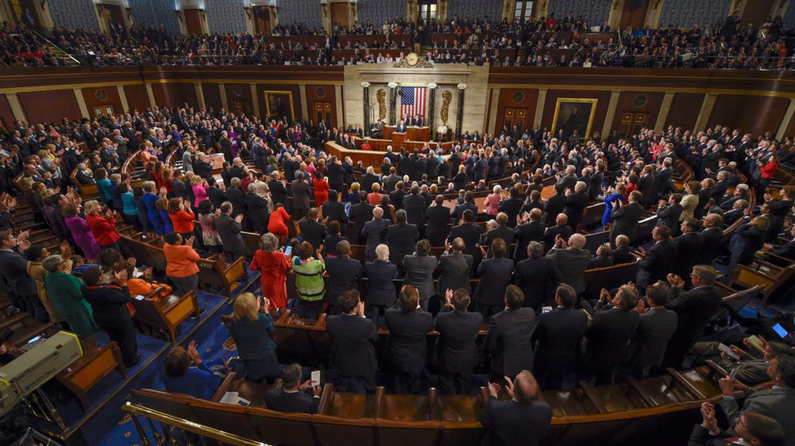
1. Apportionment of Seats in Congress
Notes:
16 states will lose or gain a seat in Congress

Slide 6
2. Effective Allocation of Federal Funds
More than $800 Billion
from the Federal Budget
Allocated Annually
Using Census Data

Slide 7
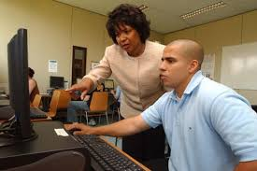
2. Using Government Funds Effectively
Notes:
Ensure public dollars have the greatest impact and are targeted appropriately
$800 billion from 300 federal programs
These are also issues that help companies determine where to locate a new office or store.

Slide 8
3. Foundation of Data-Driven Economy
Offers detailed economic and demographic data to assess potential employees, customers, products and markets:
Customers (income, age, family size, location)
Workforce skills (education)
Transportation (commuting, cost)
Example: Helps retail companies identify where to locate new stores and what products to offer on their shelves.

Slide 9
3. Billions of Dollars at Stake
The census is used to develop and test the accuracy of public and private data analyses
An inaccurate count will impact calculations and/or decisions about:
The national unemployment rate
Interest rates
Inflation rates
Exports
The Consumer Price Index
Housing sales
Construction figures
Private Databases
Notes:
Sources:
Report: In Order That They Might Rest Their Arguments on Facts”: The Vital Role of Government-Collected Data (AEI and The Hamilton Project, March 2017) (https://www.aei.org/wp-content/uploads/2017/03/THP_GovDataFacts_0317_Fixed.pdf)
Report: Why a Fair and Accurate Census Matters to Thriving Private and Public Sectors (The Georgetown Law Center on Poverty and Inequality, The Leadership Conference Fund)
(http://www.georgetownpoverty.org/wp-content/uploads/2018/07/Census-Matters-Private-Public-Sectors.pdf)
Event Video: AEI event: Making the 2020 census succeed (https://youtu.be/6kAJfzRSWAw)

Slide 10
Why is the Census Important?
Threats to an Accurate Count
How Business Can Help
Business Spotlights

Slide 11
Hard-to-count populations
Communities of color
Young children
Rural Communities
Households with unreliable internet access or low internet use
Young and mobile
Low-income households (frequent movers)
Notes:
Note: There are many reasons why each group can be difficult to enumerate including lack of understanding about the importance of the census, location, housing stability, and education, among many others. The specific factors leading to an undercount listed below for each population are only some of the many factors.
Rural households – Lack of access to internet in some regions and higher seasonal, migrant employment in rural areas may complicate a count in 2020.
Young children – Young children are the most undercounted population. There is no clear reason why children are undercounted, yet there are several factors that may contribute. Some children in lower-wage families may move rental apartments more frequently, and parents may not know they should include their young children on census forms. Children who are most likely not to be counted are kids of color, immigrants, and children in low-wage families. 25% of young kids also live in hard-to-count census tracts that present other barriers to enumeration.
Minority communities – Language barriers and a distrust of government can cause an undercount in addition to other issues pertaining to each racial/ethnic group. Location, income, and education can play a role as it does with other hard-to-count groups.

Slide 12
Citizenship Question
The question is officially off the questionnaire
Some fear that some foreign born residents may still not participate

Slide 13
Overview
Why is the Census Important?
Threats to an Accurate Count
How Business Can Help
Business Spotlights

Slide 14
Basic Census Timeline
Now Until Feb. 2020 – Education Phase (Census begins in Jan. in some remote areas)
March – April: Early Response
Late spring to summer: Door knocking (which is the most expensive phase)

Slide 15
Use Technology
Post an message and link on company website or social media to the US Census Bureau website
Post a message in an App
Kiosks for customers or employees to complete the questionnaire

Slide 16
(Pic of the 2010 Pepsi website)

Slide 17
Engage the Media
Nickelodeon lent Dora the Explorer to PSAs, flyers, and social media.
Univision wove a census message into the TV show Pequeños Gigantes

Slide 18
Customer Communications
Coffee cup sleeves
Grocery store bags
Inserts in customer mailings
Promotional materials in stores
2010 Example: Walmart put messages on televisions
2010 Example: Target printed a census message on a store circular

Slide 19
Employee Communications
Info in break rooms
Newsletters
Company intranet
Messages with paychecks
Provide time, space or equipment (tablets, computers) to complete the form.

Slide 20
Contribute Locally
Encourage staff to volunteer to promote the census at parades, festivals, local events
Provide fiscal support to local efforts

Slide 21
Why is the Census Important?
Threats to an Accurate Count
How Business Can Help
Business Spotlights

Slide 22
Business Spotlight
Ron Estrada
SVP, Corporate Social Responsibility & Community Empowerment
Univision

Slide 23
Ron Estrada
Why is the 2020 Census important for Univision?

Slide 24
Ron Estrada
How did the company decide to support a strong count and were there specific reasons that may be helpful for other companies to consider?

Slide 25
Ron Estrada
How does Univision plan to support a strong census?

Slide 26
Business Spotlight
Nancy Moody
VP of Public Affairs, DTE Energy
DTE Foundation Chair

Slide 27
Nancy Moody
Why is the 2020 Census important for DTE Energy?

Slide 28
Nancy Moody
How did the company decide to support a strong count and were there specific reasons that may be helpful for other companies to consider?

Slide 29
Nancy Moody
How does DTE Energy plan to support a strong census?

Slide 30
Business Spotlight
Don Lowery
SVP. Corporate Reputation,
Public Affairs
Nielsen

Slide 31
Don Lowery
Why is the 2020 Census important for Nielsen?

Slide 32
Don Lowery
How did the company decide to support a strong count and were there specific reasons that may be helpful for other companies to consider?

Slide 33
Don Lowery
How does Nielsen plan to support a strong census?

Slide 34
Don’t Do it Alone
Join ReadyNation’s Business for the 2020 Census listserv (free, private, no obligations)
Executives and senior leaders already involved:
REMAX
Univision
DTE Energy
Nielsen
Crayola
Scholastic

Slide 35
Don’t Do it Alone
Join the Census Bureau National Partnership Program
Local Complete Count Committees

Slide 36
Find All of this Information in Our Report

Slide 37
Questions?

Slide 38
Thank You!
Contact Info:
Jeffrey Connor-Naylor
202-464-7005 X511
jnaylor@readynation.org
Visit: strongnation.org/census

